Slide 1
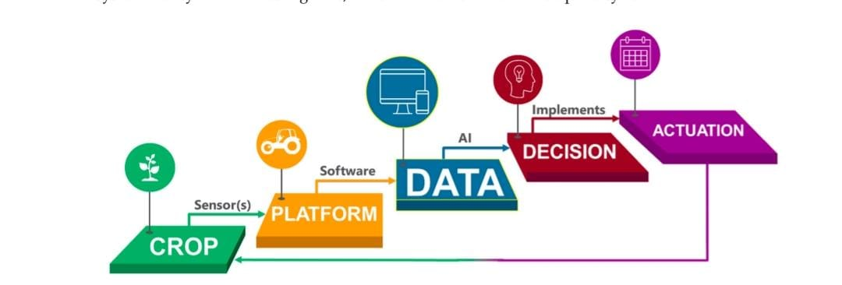
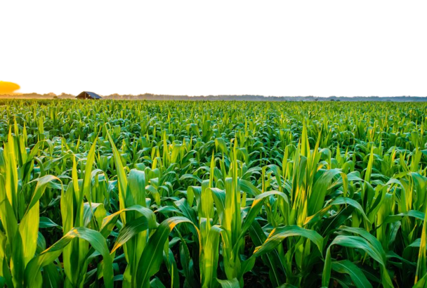




CUSTOMER JOURNEY MAP
Precision and Smart Farming.
Management Zones
Remote Sensing.
Proximal Sensing.
Big data.
Internet of things mapping.
Decision Supporting system.
Variable Rate application

